Slide 1
How Do You Start A Short-Term Rental?
Register with Massachusetts, register with the Mass Department of Revenue, obtain appropriate insurance and start operating your short-term rental; or
Use Short-Term Rental Platforms:
AirBnB
HomeAway/VRBO
Booking.com
TripAdvisor
HomeStay.com
Agoda
Turnkey
Expedia
Ocxee

Slide 2
Massachusetts Registry
All operators must register with the State of Massachusetts and obtain a certificate number.
This certificate number will be needed by the intermediary (AirBnB, VRBO) to remit the taxes on behalf of the operator.
https://licensing.reg.state.ma.us/StrRegistry/

Slide 3
AirBnB – Becoming a Host
Register with AirBnB
Identity Verification
Email and Phone Verification
Host is responsible for understanding and complying with local laws, regulations, registration requirements, rental agreements
Host must include Massachusetts registry number in the system in order to maintain a listing on AirBnB
Provide relevant information for tax purposes
In Massachusetts AirBnB collects state and local taxes

Slide 4
Property Options - AirBnB

Slide 5
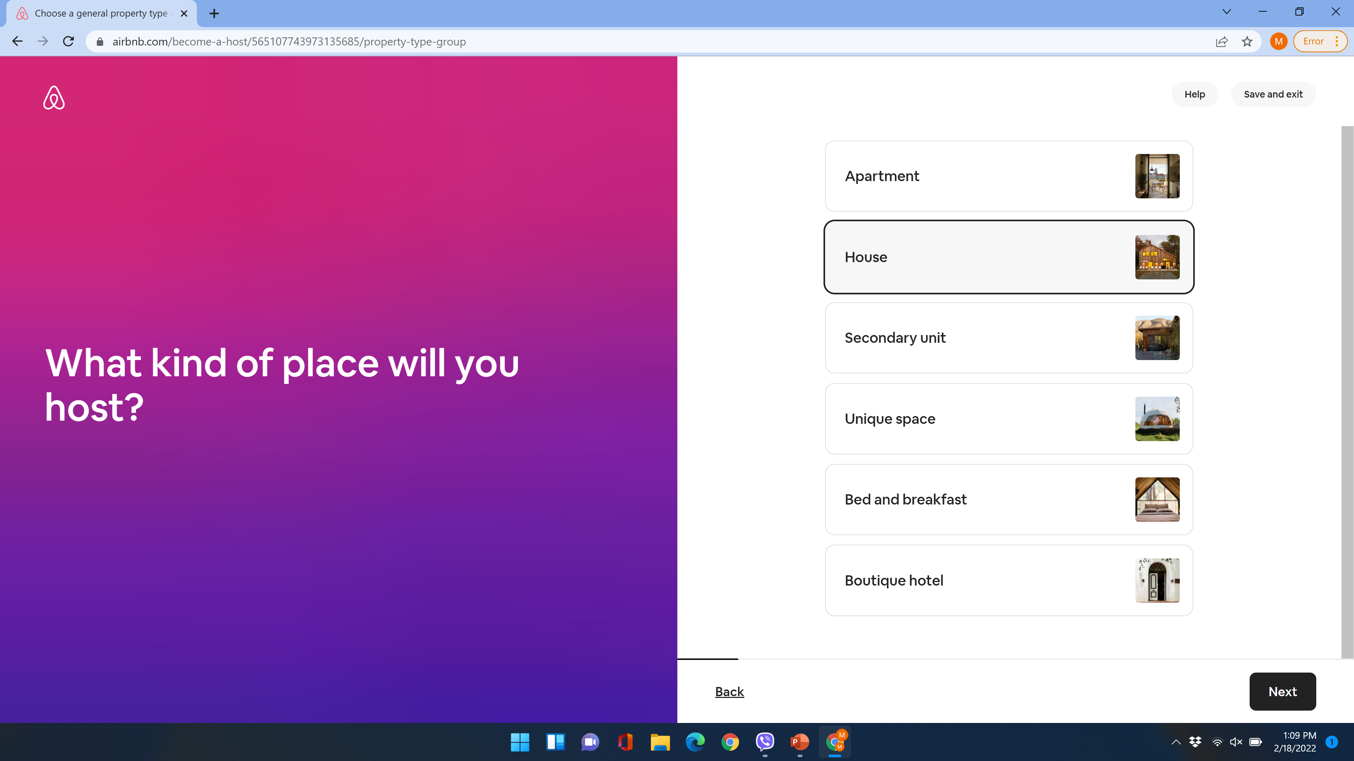

Slide 6
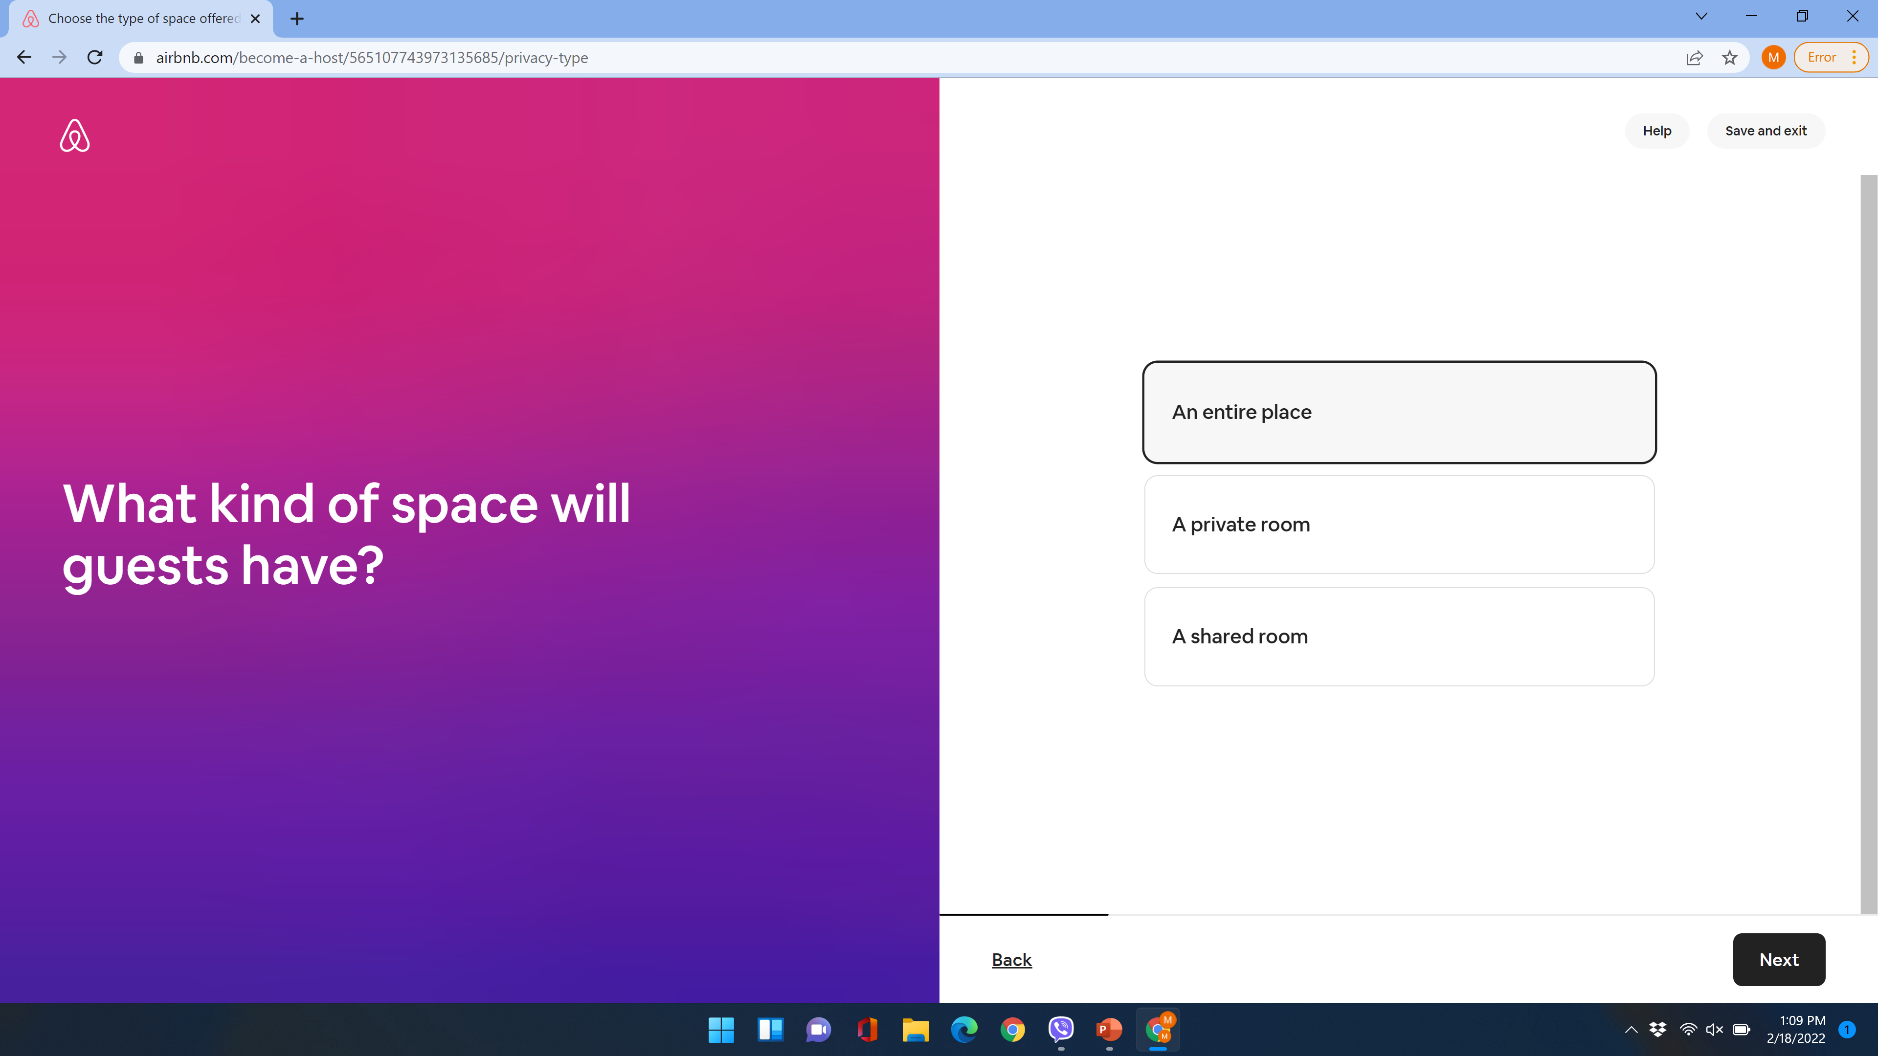

Slide 7
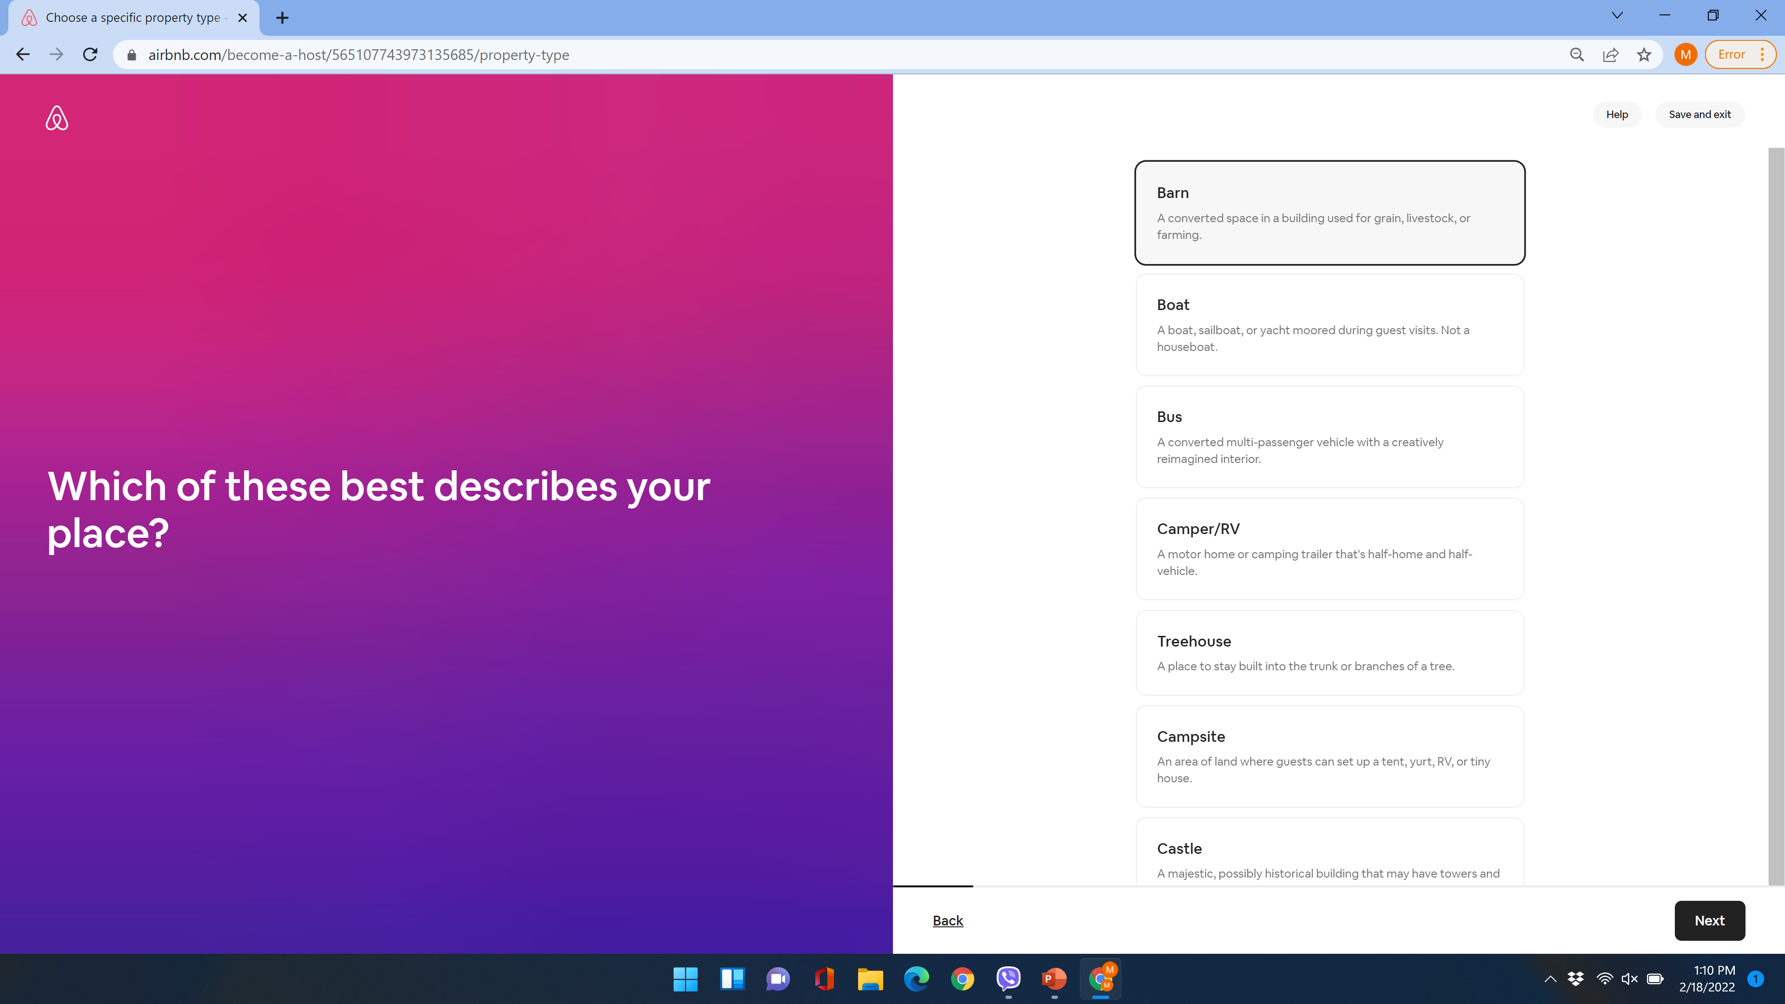

Slide 8
Property Description
As part of the listing description, AirBnB provides an option for hosts to identify safety features.
Smoke Detectors
Carbon monoxide Detectors
First Aid Kit
Fire Extinguisher
Host can create Home Manual that may include information related safety etc.
AirBnB also provided hosts training on cleaning practices and other information on how to keep guests safe due to the pandemic.

Slide 9
How Do Guests Evaluate Property?
Guests read host/property reviews
When looking for a property, guests can review home features to ensure that the particular short-term rental is safe, cleaning practices etc.

Slide 10
VRBO/HomeAway
Hosts get registered on the platform in a similar fashion as AirBnb.

Slide 11
VRBO/HomeAway Property Types

Slide 12
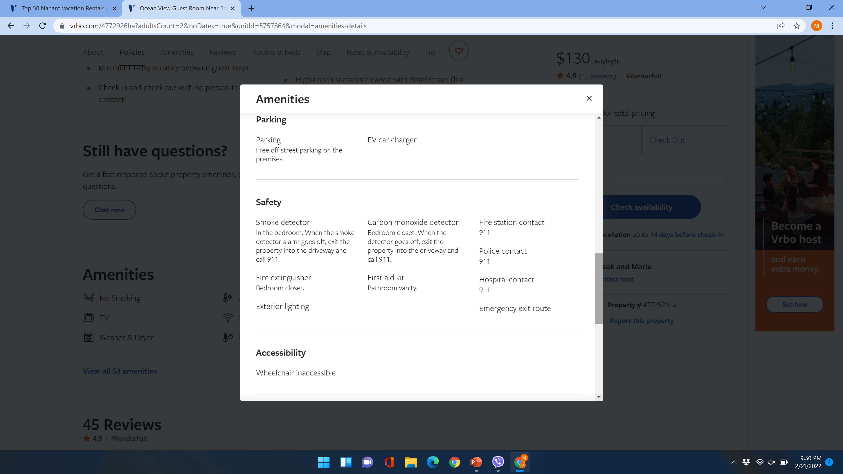
Safety Features Listed on the Site

